Slide 1
Protecting Individuals and Organizations from Stealthy Cyber Attacks
Mitigating Keylogger Threats: A Cybersecurity Solution
Presented By:
SRIRAGHAVAN K (3RD YEAR CSE)
SRI MUTHUKUMARAN INSTITUTE OF TECHNOLOGY

Slide 2
OUTLINE
Introduction
Problem Statement
Proposed System/Solution
System Development Approach
Algorithm & Deployment
Result
Conclusion
Future Scope

Slide 3
introduction
In today's digital age, cybersecurity threats are ever-present and evolving at an alarming rate.- Among these threats, keyloggers stand out as stealthy software tools designed to monitor and record keystrokes on a user's computer without their knowledge.- Keyloggers pose a significant risk to both individuals and organizations, as they can capture sensitive information such as passwords, credit card details, and other personal data, leading to identity theft, financial loss, and privacy breaches.

Slide 4
Problem Statement
In today's digital age, where cybersecurity threats loom large, one of the significant concerns is the proliferation of keyloggers, stealthy software tools designed to monitor and record keystrokes on a user's computer without their knowledge. Keyloggers pose a severe threat to individuals and organizations as they can capture sensitive information such as passwords, credit card details, and other personal data, leading to identity theft, financial loss, and privacy breaches.

Slide 5
Proposed Solution
Our solution combines signature-based detection, anomaly detection, and behavior analysis to effectively combat keylogger threats.
Utilizing machine learning, our system dynamically adapts to new threats, ensuring continuous protection.
Proactive prevention features such as real-time keystroke encryption and secure input handling mitigate data compromise.
User education is emphasized, with built-in training modules to empower users in recognizing and responding to keylogger threats.
Lightweight and compatible, our solution seamlessly integrates with existing cybersecurity infrastructures for easy deployment and management.
Regular updates and threat intelligence feeds keep our solution resilient against emerging threats.

Slide 6
System Approach
Language: Our solution is developed primarily in Python, leveraging its versatility and extensive library support.
Libraries: We utilize Tkinter for GUI development, pynput for keyboard monitoring functionality, and json for data serialization.
System Requirements: The system requires a Python environment with Tkinter and pynput libraries installed.
Methodology: Our development methodology follows agile principles, with a focus on user requirements, modularity, and rigorous testing.
Development Process: We prioritize user-centric requirements gathering, followed by iterative development cycles emphasizing code quality and reliability.
Testing and Quality Assurance: Rigorous testing, including unit tests and integration tests, ensures functionality, security, and performance.
Deployment and Automation: Automation tools such as Jenkins and Docker streamline deployment processes, ensuring efficiency and consistency.
Monitoring and Maintenance: Post-deployment monitoring mechanisms track system performance and security incidents, enabling proactive maintenance and updates.

Slide 7
Algorithm & Deployment
Algorithm Overview:
Our keylogger detection algorithm is designed to analyze keystroke patterns in real-time.
It distinguishes between normal typing behavior and potentially malicious keylogger activity.
Data Input:
The algorithm takes input from keystroke events captured by the pynput library.
It also considers contextual information such as timestamps and application focus.
Training:
The algorithm employs a heuristic approach and learns from observed keystroke patterns.
It continuously refines its detection capabilities based on real-world usage scenarios.
Prediction:
Once deployed, the algorithm monitors keystroke events in real-time.
Suspicious patterns trigger alerts, indicating potential keylogger activity.

Slide 8
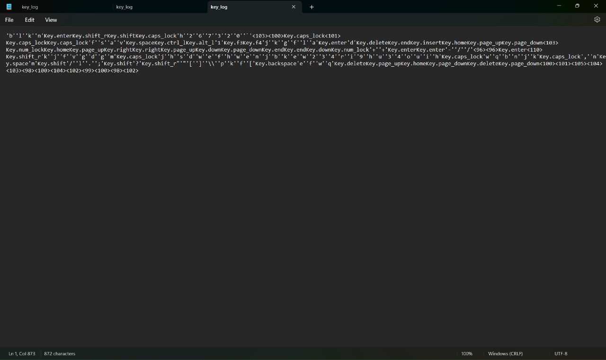
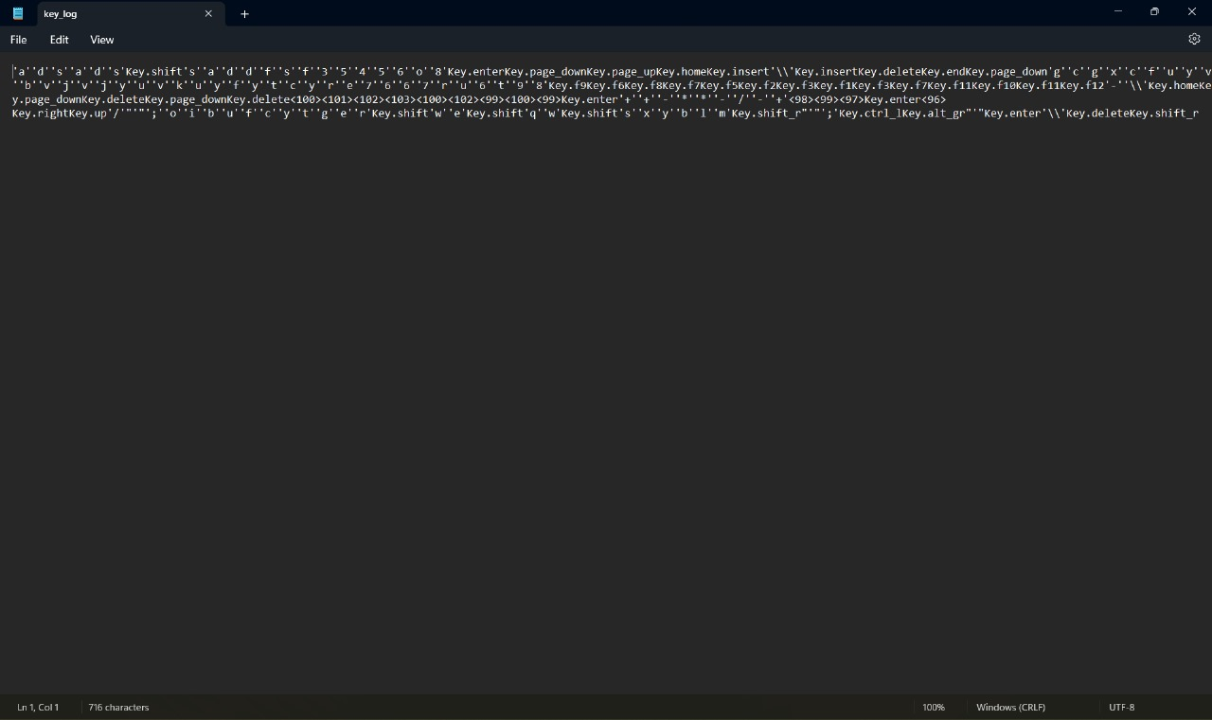
Result

Slide 9
Conclusion
In conclusion, keyloggers represent a formidable cybersecurity challenge, demanding proactive mitigation strategies.
Our solution offers a robust defense against keylogger threats, ensuring the security and integrity of sensitive information.
By investing in innovative cybersecurity solutions, we empower individuals and organizations to navigate the digital landscape with confidence.

Slide 10
Future scope
Looking ahead, our solution holds promise for further enhancements and innovations.
We envision integrating additional machine learning techniques and data sources to enhance detection accuracy.
Furthermore, seamless integration with existing cybersecurity frameworks will extend the reach and effectiveness of our solution.

Slide 11
THANK YOU

